Slide 1
Analysis
WK DSS 220, Module 3, Lesson 3
Notes:
Welcome everyone to the Analysis phase of the data science workflow.

Slide 2
The Data Science Workflow
Ask questions
Prepare and Plan
Process
Analyze
Share and Act
Notes:
So we’ve created a goal for the project, studied and cleaned our data. We’re now ready to analyze it.

Slide 3




Common Data Science Problems
Connections
Predictions
Categorize
Trends
Notes:
As a data scientists, these are some typical problems that you might encounter.
You might need to discuss how different events, groups, or data are connected
You might need to predict future events based on what you know from the past
You might need to categorize observations, such as self-driving cars labelling images as pedestrians, other cards, street signs, etc.
You might need to uncover trends.
For each of these, you’ll use analysis and it’s important to determine which kind of analysis you need based on the goal.

Slide 4
Analyze
Data?
Continuous
Discrete
Estimation
Classification
Notes:
If we are looking to build a model to find continuous values, such as time, distance or dollar figures, then we should use estimation methods.
If we want to find discrete values, such as "threat" or "no threat", then choose classification models.

Slide 5

Estimation
Notes:
So first let's go over an example of estimation

Slide 6
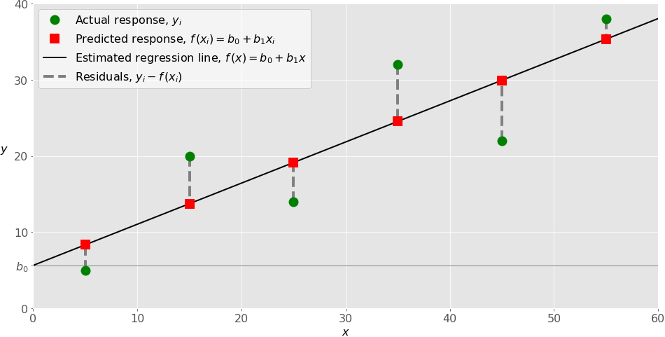
Actual
Residual
Estimated
Notes:
This is an example of using a method called Linear Regression to fit a line to some data.
The X-axis is called the "independent" variable, and the Y-axis values are "dependent" values as their value depends on what the X-value is.
The green dots in this figure are the actual data, and the red dots are where the line predicts them to be.
The difference between the predicted and actual values is the "Residual Error" or just "Residual"
Now if you plot the histogram of these residuals, as long as they show a normal distribution with a 0 (zero) mean, the theory of Linear Regression guarantees an optimal fit.

Slide 7

Actual
Residual
Estimated
$$MSE= \frac{1}{n}\sum_{i=1}^{n}{{\left(Estimated−Actual\right)}^{2}}$$
Notes:
Now let's go over measuring how well your line fit the data. This gives you an idea of how dependent the Y variable is on the X variable.
Mean Squared Error is the average of the squared of the residuals.
Why square?
Penalizes large errors --> larger errors squared are exponentially larger
Cons: Can be large because squared

Slide 8
Actual
Residual
Estimated
$$RMSE= \sqrt{MSE}$$
Notes:
Root Mean Squared Error is the main way to measure estimation accuracy of your linear regression model
It measures the variation in the estimation errors of the training set.
Being the square root of a square, we get numbers in the same units as the original data – easier to understand

Slide 9
Actual
Residual
Estimated
$$R^{2}\text{− }\text{Coefficient} \text{of} \text{Determination}$$
Notes:
R-Squared or Coefficient of Determination
Calculation is somewhat more involved then MSE or RMSE. It uses the predicted, actual and mean values
Considered a normalize metric – gives you a 0-1 number that allows models to be compared even if they are based on very different ranges of data
1 = better fitting model / 0 = less well fitting model
Cons are that R^2 always increases when you add variables. So you could add variables that are very lightly influencing the Y values, and it will still improve your R^2.
So it encourages using a lot of variables. That was an issue when computing resources were limited, but not much nowadays.

Slide 10

Classification
Notes:
Now if you’re trying to find a discrete value, then you would use classification

Slide 11









Analysis Model
Notes:
Typically a classification model is trained by showing it many examples of labelled data. The labelled part is important because we need true sources of data so that the model can determine the differences between different classes of images and learn how to differentiate between them.

Slide 12
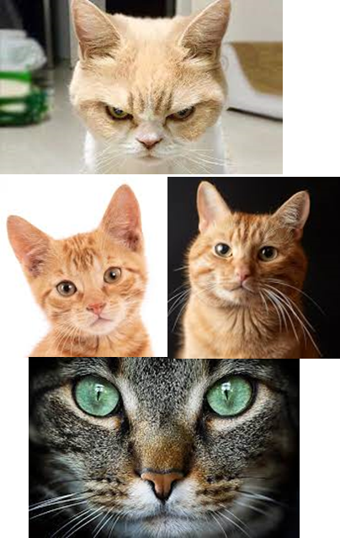
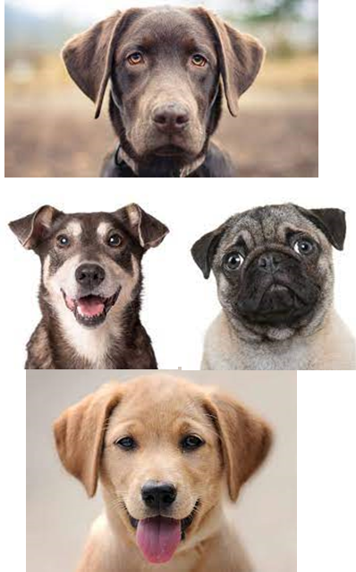
Decision Tree
Root
Yes
No
Leaf
Internal Node
Yes
No
Leaf
Leaf
Notes:
For our first analysis algorithm, I’ve chosen a Decision Tree because it is very intuitive and many people are familiar with them even before getting into data science.
We start at the top at the Root Node where we have all of our observations.
Then we use different criteria to split the data set into subsets that group the classes together.
If a split results in observations of only one class (i.e. pure), then it is called a Leaf Node.

Slide 13
Decision Tree
Triangle Ear?
Yes
No
Cat
Whiskers?
Yes
No
Cat
Dog
Notes:
(Walk through example)

Slide 14

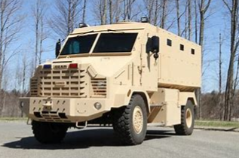


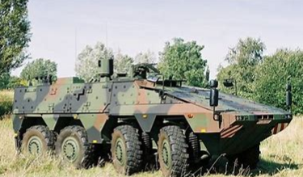




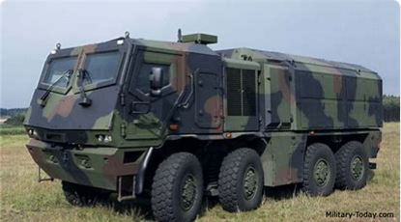
Example 2
Mil
Civ
Notes:
As another example, here we need to differentiate these images of military and civilian vehicles.

Slide 15
Tree_1
Passengers visible?
Yes
No
Civ
Big Tires?
Yes
No
Mil
Civ
Notes:
(Walk through the split criterion)

Slide 16
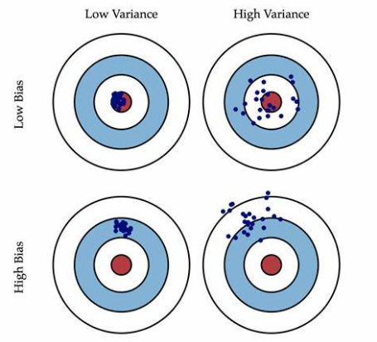
Bias vs Variance
Notes:
When dealing with classification models, it’s important to know where they go wrong.
Bias is one type of error that occurs due to wrong assumptions about data such as assuming data is linear when in reality, data follows a complex function.
On the other hand, variance gets introduced with high sensitivity to variations in training data.

Slide 17
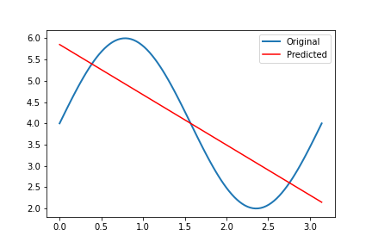
High Bias
Notes:
When you make an incorrect assumption of the data, and you fit incorrectly, you tend to end up with a high biased model.

Slide 18
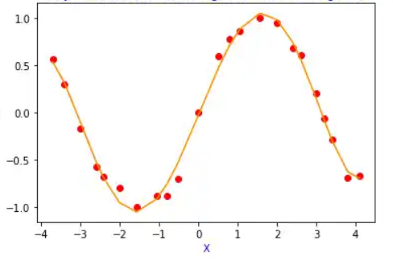
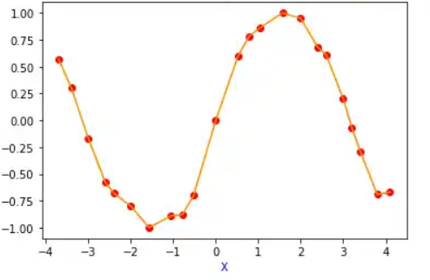
Spot the Difference
Notes:
Overfitting to the training set leads to high variance of results when using a different test set.
Can you see how the curve on the right passes through every data point (red dots)? Fitting too closely to the training set will lead to larger errors in the test set.

Slide 19
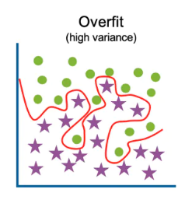
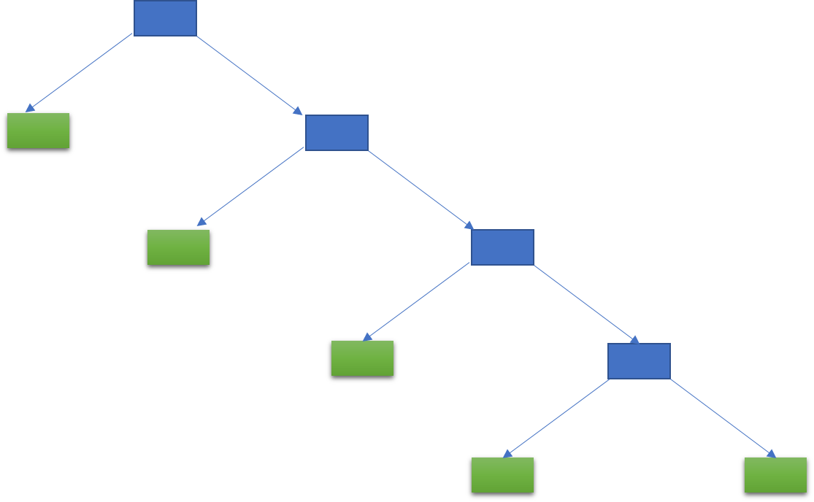
Bias Vs Variance
Notes:
Decision Trees are generally low bias. But overfitting leads to high variance

Slide 20
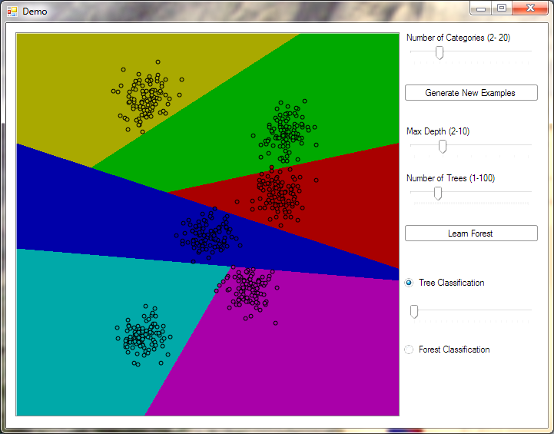
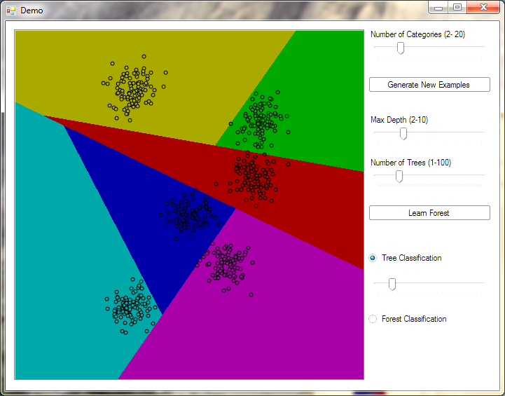
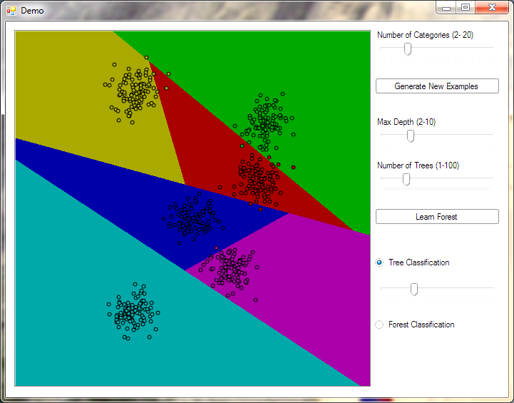
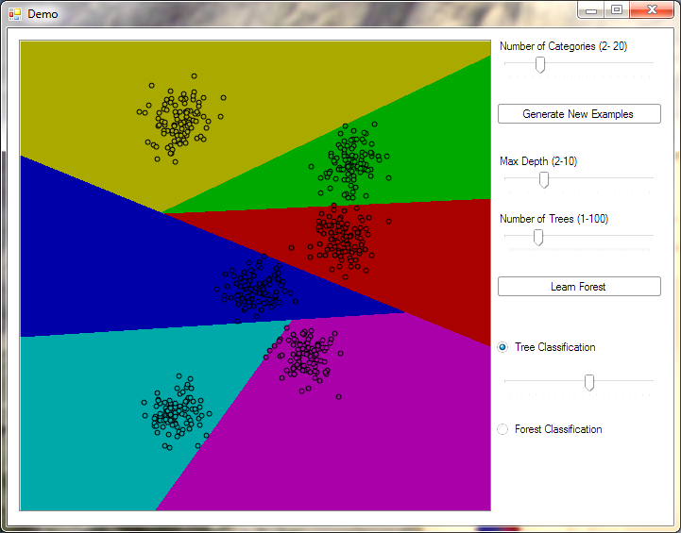
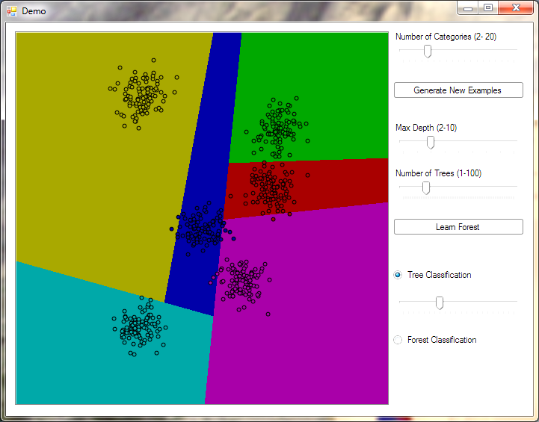
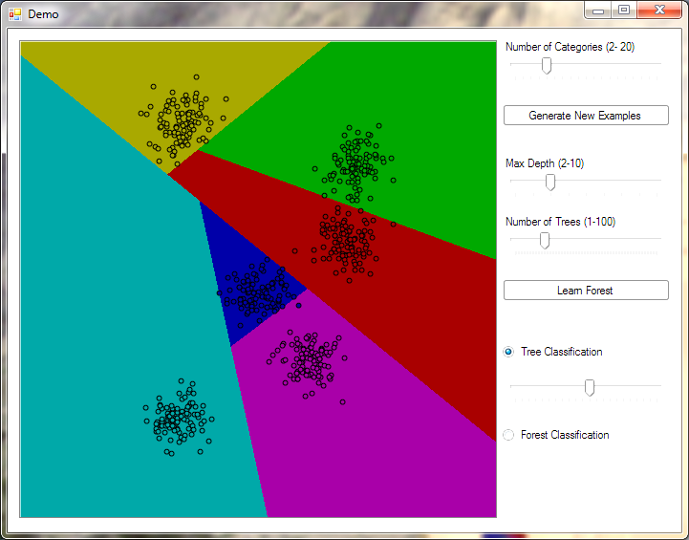
High Variance
Notes:
High variance means that different decision trees can break up the decision space in many different ways.

Slide 21

Notes:
So how can you keep the low bias but reduce the high variance of decision trees?
Let them each vote.

Slide 22
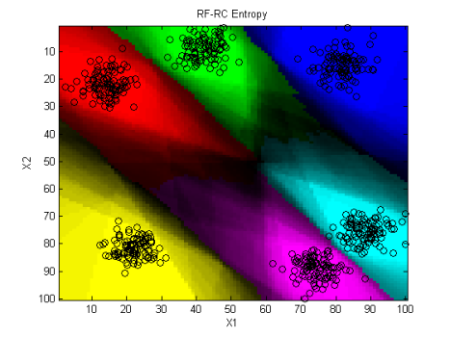
Ensemble Learning
Notes:
When you do that, you get different decision trees identifying a space in different ways. The majority wins.
But you also get a measure of certainty of the decision in the number of votes for the winning category. For example, if there are 2 classes, and 51% of the decision trees in this ensemble voted for class A, then that’s not a very confident decision.

Slide 23
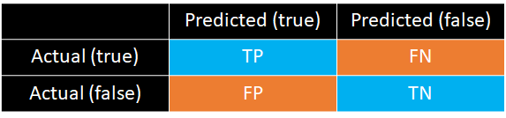
Metrics
Accuracy (ACC) = (TP + TN)/(P + N)
Precision = TP / (TP + FP)
Recall = TP / (TP + FN)
F1 = 2 x (Precision x Recall) / (Precision + Recall)
Notes:
There are different metrics to see how well your model is doing. Shown here is the confusion matrix, which shows correctly and incorrectly predicted observations.
Precision explains how many of the correctly predicted cases actually turned out to be positive. Precision is useful in the cases where False Positive is a higher concern than False Negatives.
e.g. where wrong results could lead to customer churn and this could be harmful to the business. Or recommender system that falsely flags a potential customer, leading to claims of harassment.
DT Testing Example: Or what if you have a warning sign that goes off all the time incorrectly? It will lead to the operator either wasting time, but in the long run ignoring it and possibly ignoring a true warning too.
Recall explains how many of the actual positive cases we were able to predict correctly with our model. It is a useful metric in cases where False Negative is of higher concern than False Positive. It is important in medical cases where it doesn’t matter whether we raise a false alarm but the actual positive cases should not go undetected!
- Or airport screener – don’t want to miss someone who should have been flagged.
F1 or “F score” uses both precision and recall. Does not use True Negatives, so not always advisable to compare F-scores across different datasets.

Slide 24
Scikit-Learn Methodology
Split Data into Training/Test sets
Setup/Define the Classifier
Train the Classifier
Predict

